Slide 1
CORS ADVISOR
Done by: Sam – Jonathan chiam
– Lacie Fan

Slide 2
Our aims
To allow easy access to past reports of bidding statistics for all modules
To provide sound advice on the minimum required bid point for a particular module
To establish a comprehensive graphical trend of past year bidding information.

Slide 3

User story 1
As a returning student, I will like to be able to make an informed decision on the number of bid points to invest in the bidding of a particular module.
Jake

Slide 4
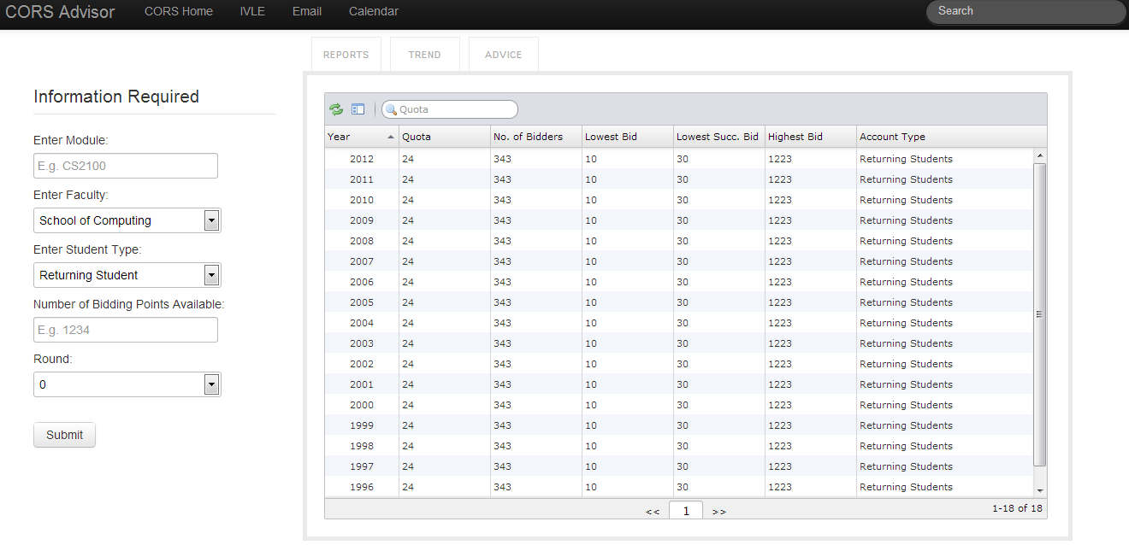
User story 1

Slide 5

User story 2
As a student, I will like to be able to observe bidding trends to assess the demand of a particular module.
Ron

Slide 6
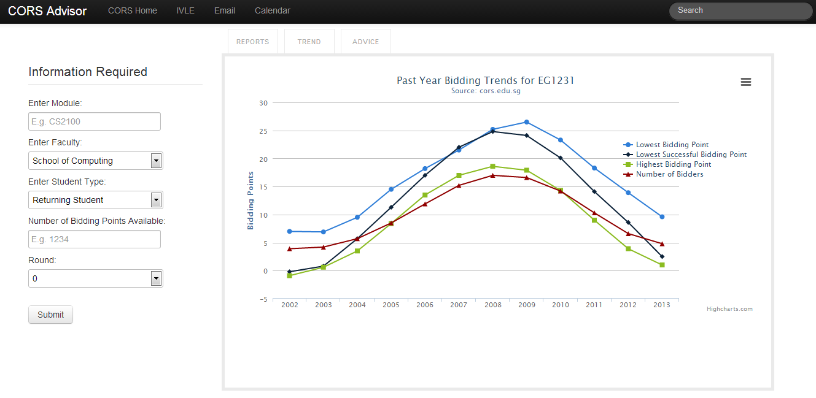
User story 2

Slide 7

User story 3
As a freshman, I would like to familiarise myself to CORS and retrieve useful bidding information easily
Peanut

Slide 8
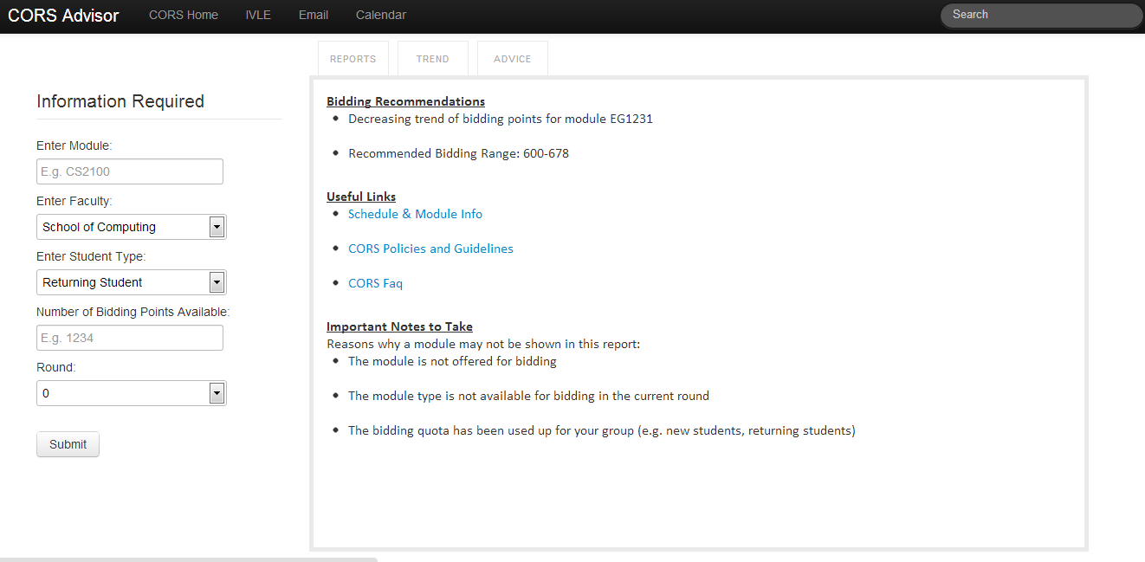
User story 3

Slide 9
Miscellaneous
Features that we are still working on:
Bidding recommendations
Extracting data from CORS Archives
Refining the layout and interface

Slide 10

Thank You!

